Slide 1

Project Title: Movie Ticket Booking System
FSD PROJECT REVIEW
Presented To:
CAPGEMINI
Team 2:
Karthik Raj S
Vigneshe B
Hariharan Dhanapathy

Slide 2
Problem Statement
The traditional way of going to cinemas can be difficult for customers as customers need to know the availability of seats, show timings, and movie options, especially when there are multiple cinemas in a location.
The present solution for a online booking system might not be sufficient as there needs to be certain more implementations like having age restrictions to watch an A rated movie, and loyalty programs.

Slide 3
Objectives
The previous slide which deals with the problem statement gives way to these objectives which are kept in mind while designing the website:
Implement a fully functioning online movie ticket booking system.
Implement a responsive high level customer or user interaction with seamless access to their ticket information.
Implement a system where the booked/reserved users can download their tickets and present it as a proof of booking.
Implement age restrictions on people going to a movie with A rating.
Implement a loyalty program scheme for returning users.

Slide 4
Features
Convenience: Online movie ticket booking provides a convenient way for people to buy movie tickets from the comfort of their own homes or on the go, without having to wait in long queues at the box office.
Time-saving: Online ticket booking saves time as customers can book their tickets in advance and avoid the last-minute rush.
Availability: Online movie ticket booking ensures that customers have access to all available seats in the theater, giving them the freedom to choose the best seats as per their preference.

Slide 5
Future Implementations
Future Implementations:
Payment Interface would be added for booking each movie ticket.

Slide 6




Technology Stack
Frontend | Reactjs
Backend | Spring Boot
Database | MySQL
ORM | JPA(Hibernate)
Testing | Junit and Mockito
Code Coverage | Eclemma

Slide 7
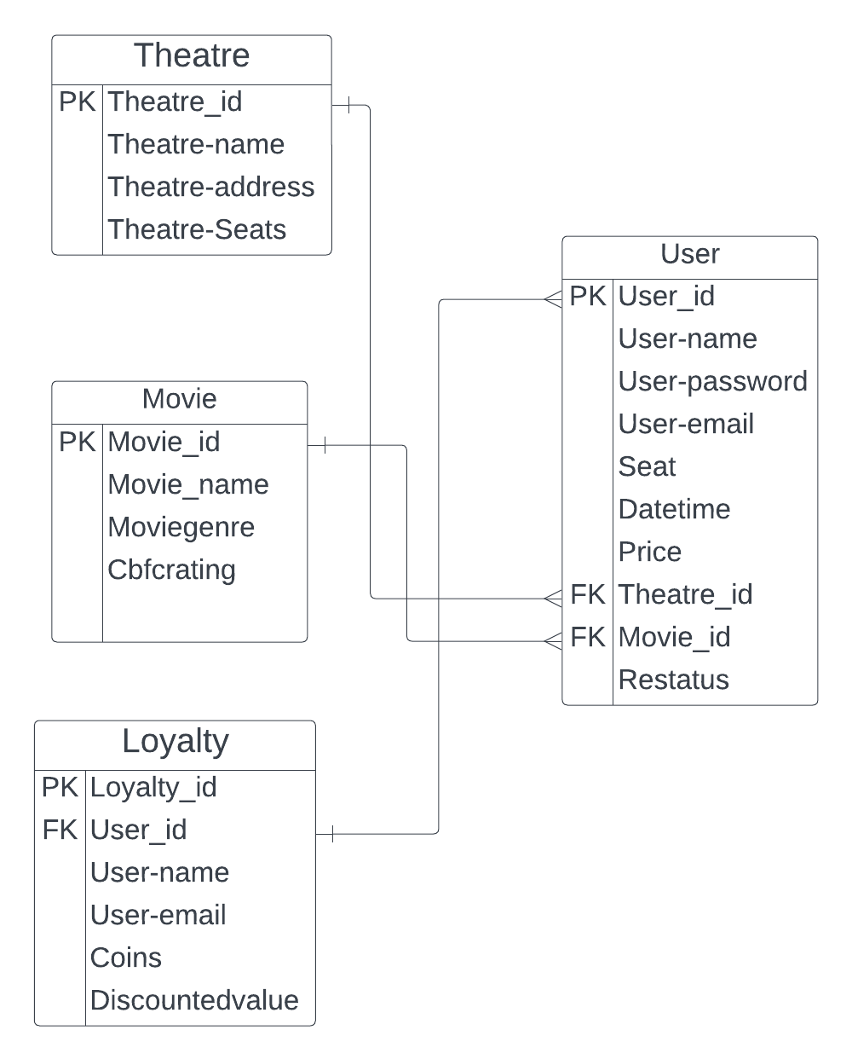
Entity-Relationship Diagram

Slide 8
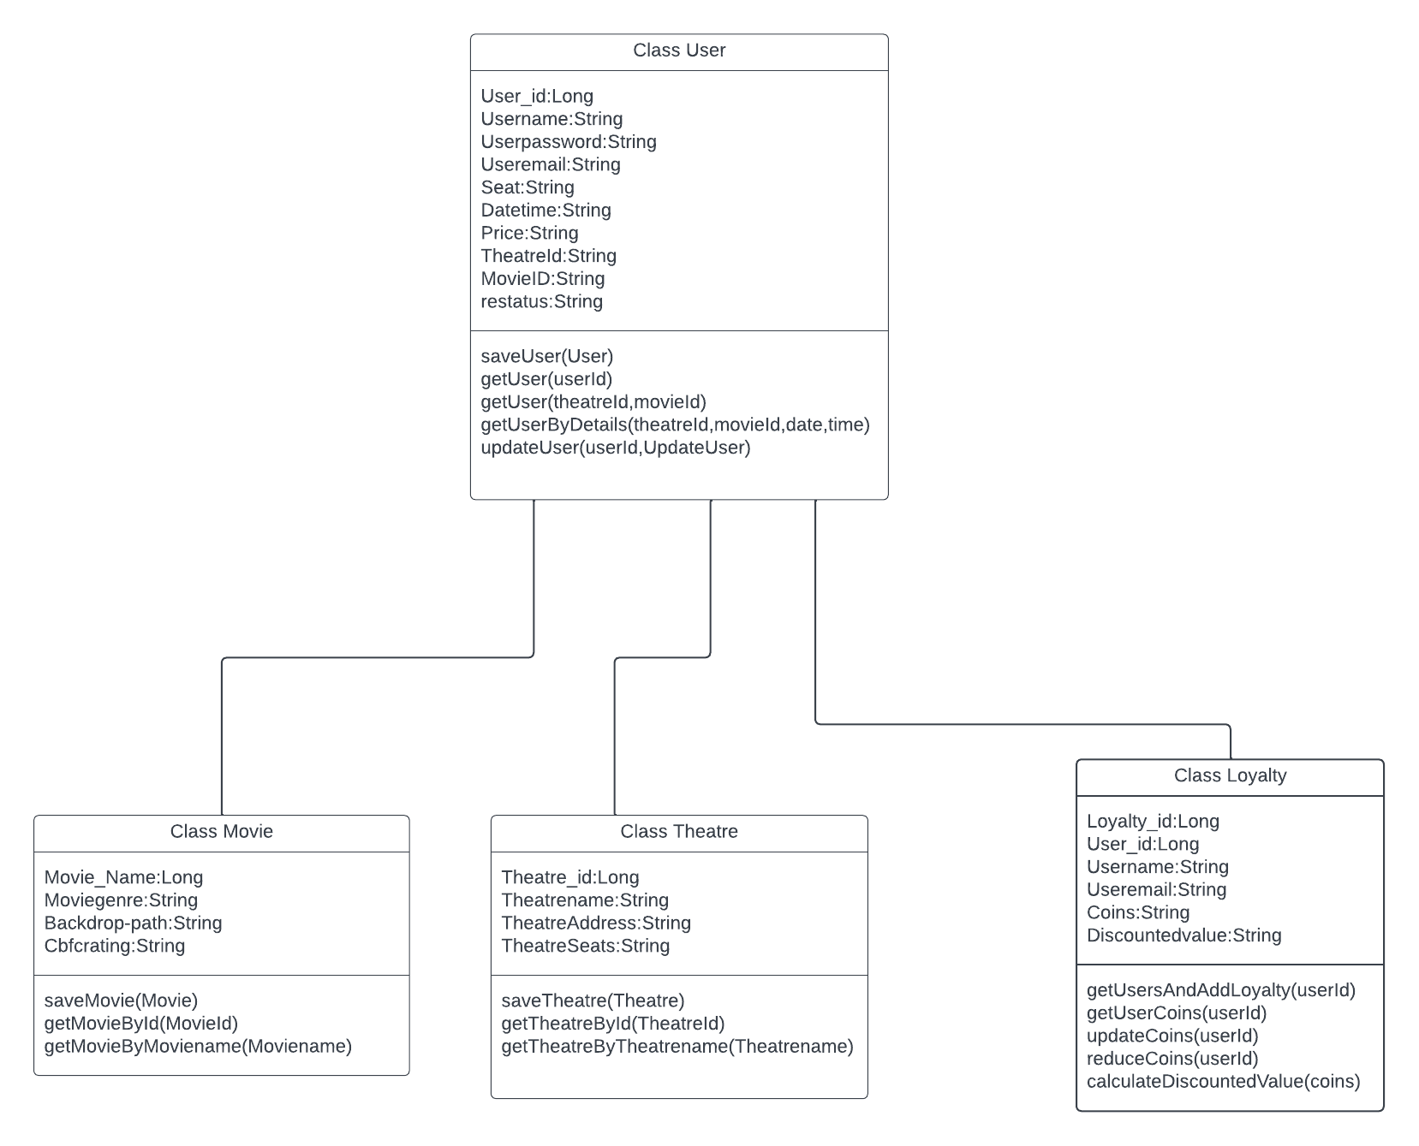
Class Diagram

Slide 9
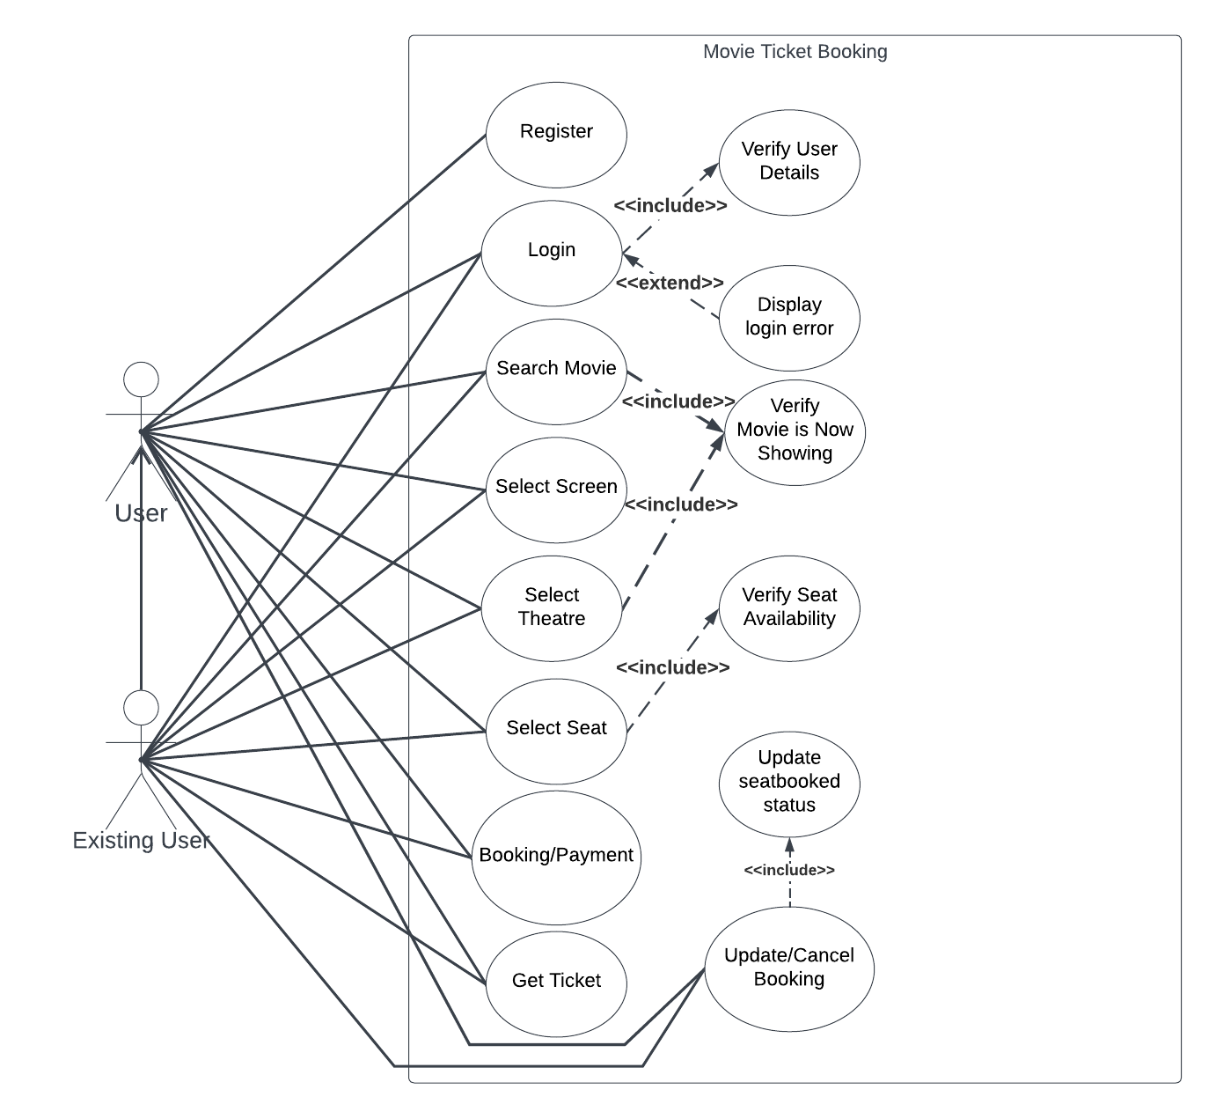
Use-Case Diagram

Slide 10
Concurrent Bookings
Here we are using “LockModeType.PESSIMISTIC_WRITE” type of lock to lock the database while the transaction is happening.
Here we use an instance of ReentrantLock() which returns a Lock object lock which is used with the tryLock() method.
Using lock.tryLock() function we make sure that if there are multiple threads executing concurrently ,and one thread has already acquired the lock the remaining thread requests return an Internal Server Error exception.

Slide 11
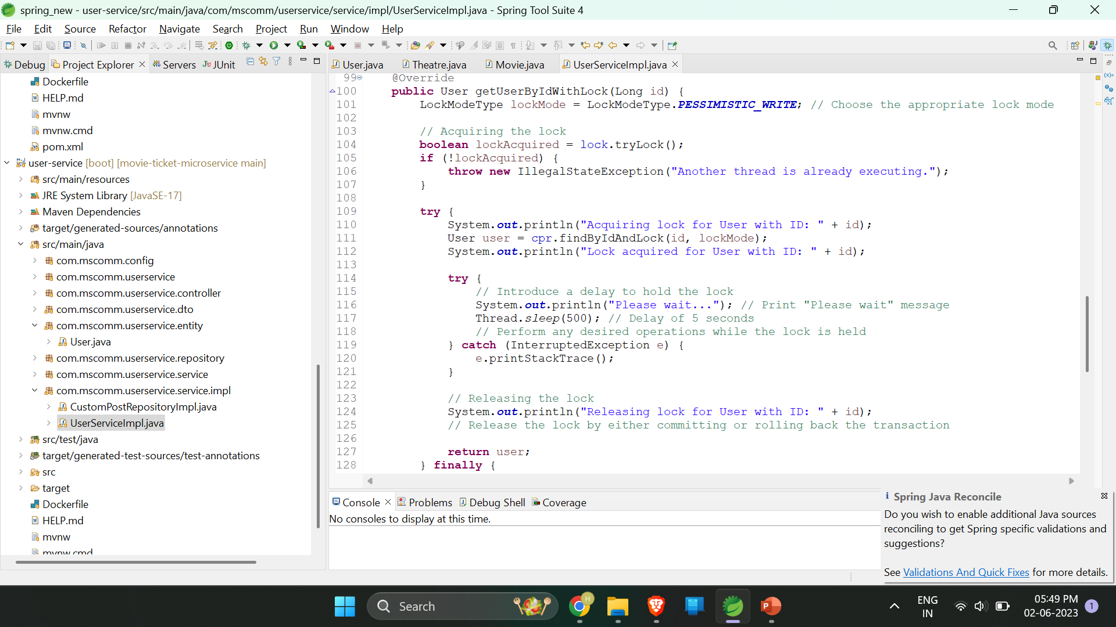
Concurrent Booking Code Segment(Service)

Slide 12
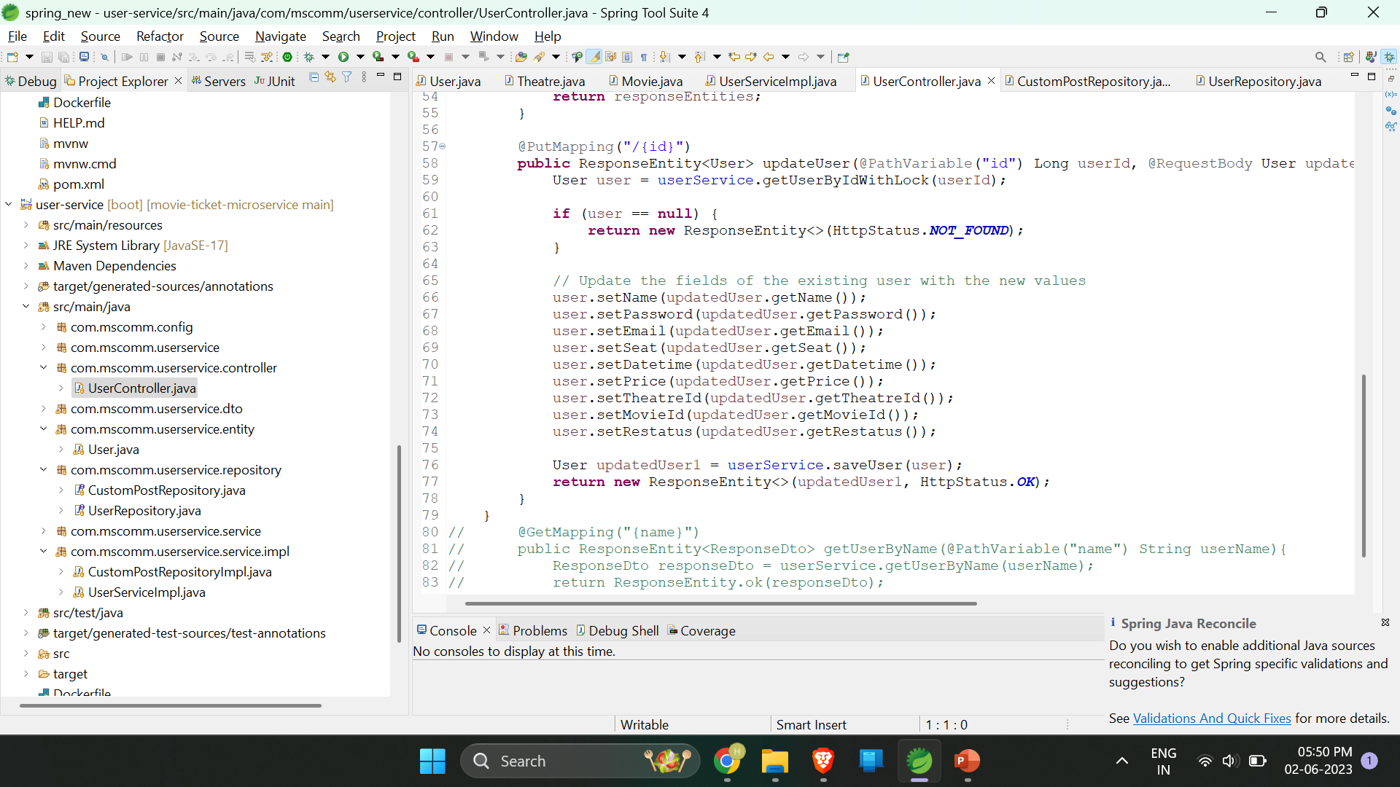
Concurrent Booking Code Segment(Controller)

Slide 13
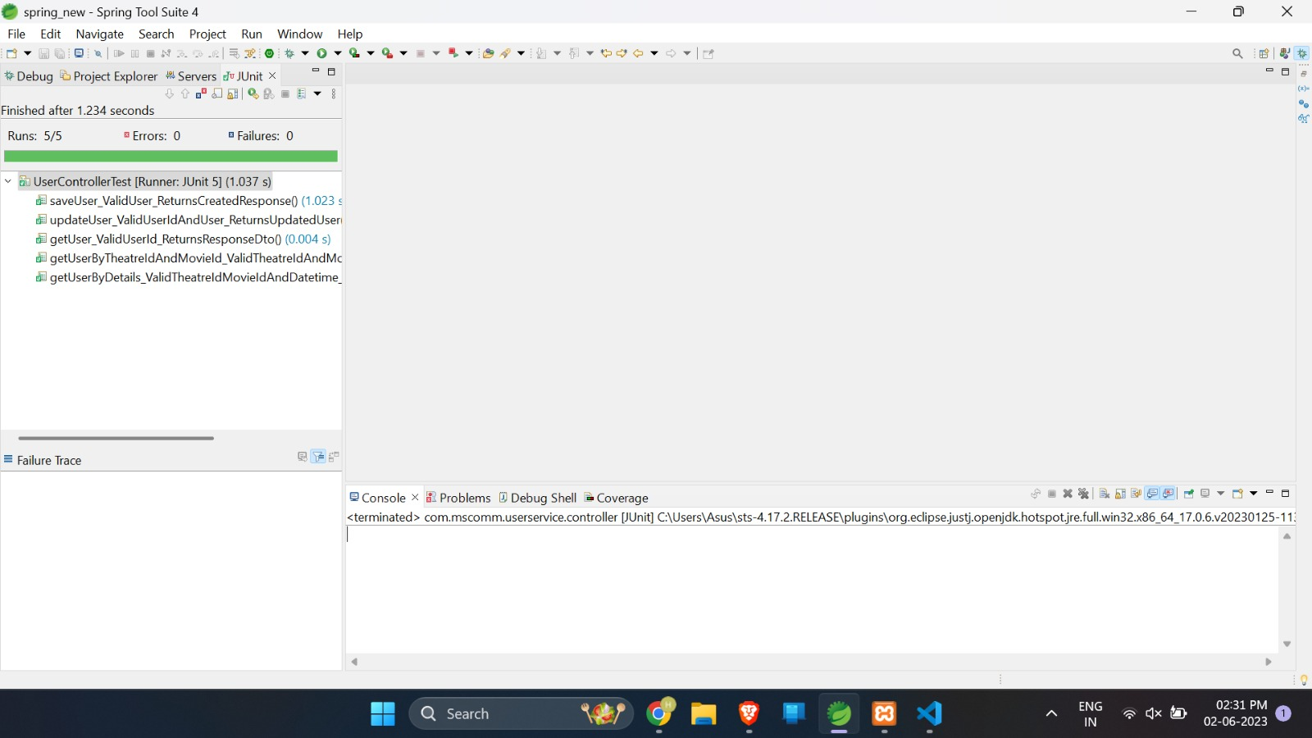
User-service controller test

Slide 14
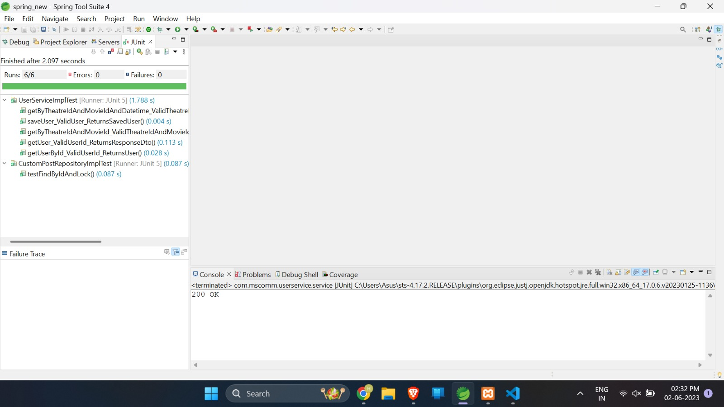
User-service service test

Slide 15
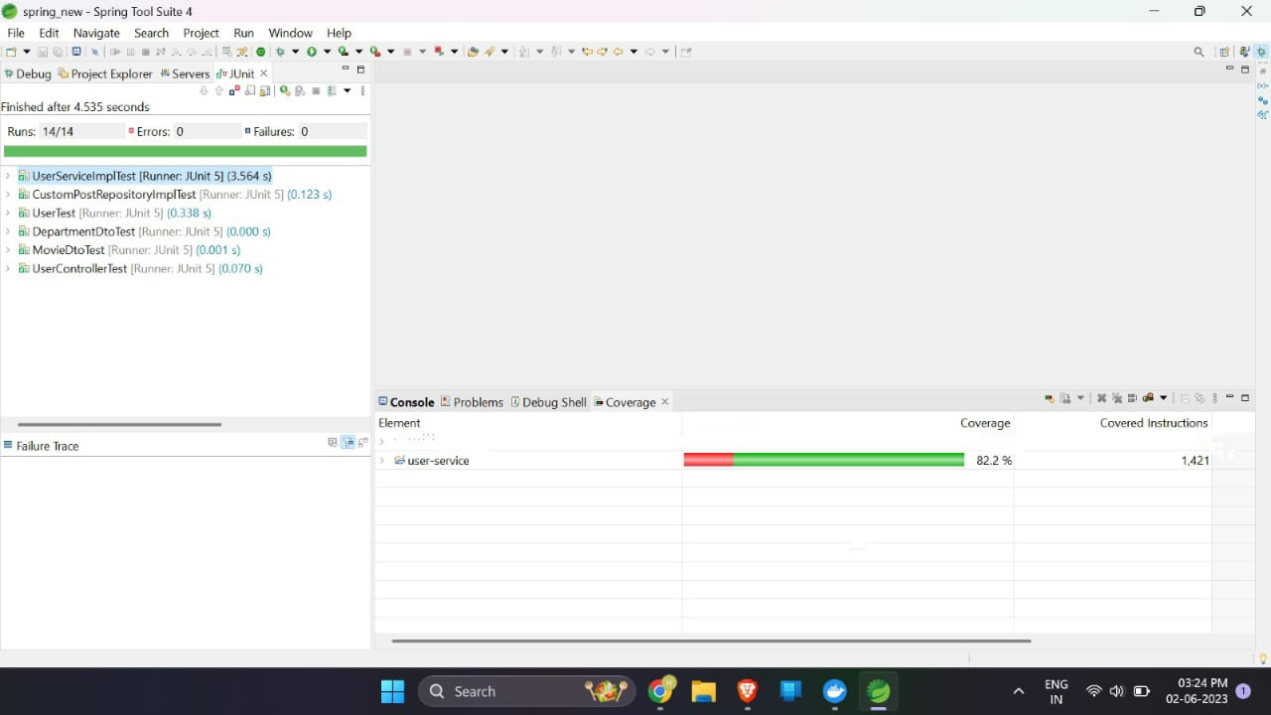
User-service code coverage

Slide 16
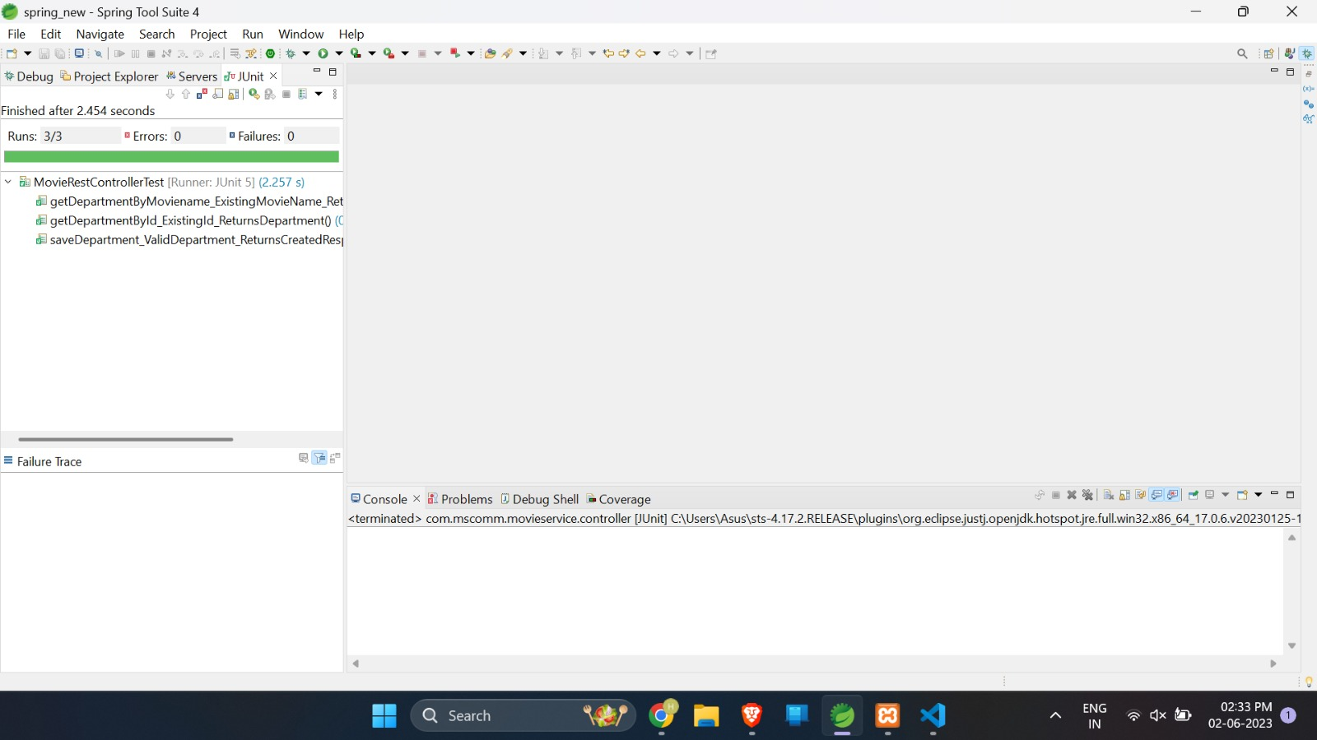
Movie-service controller test

Slide 17
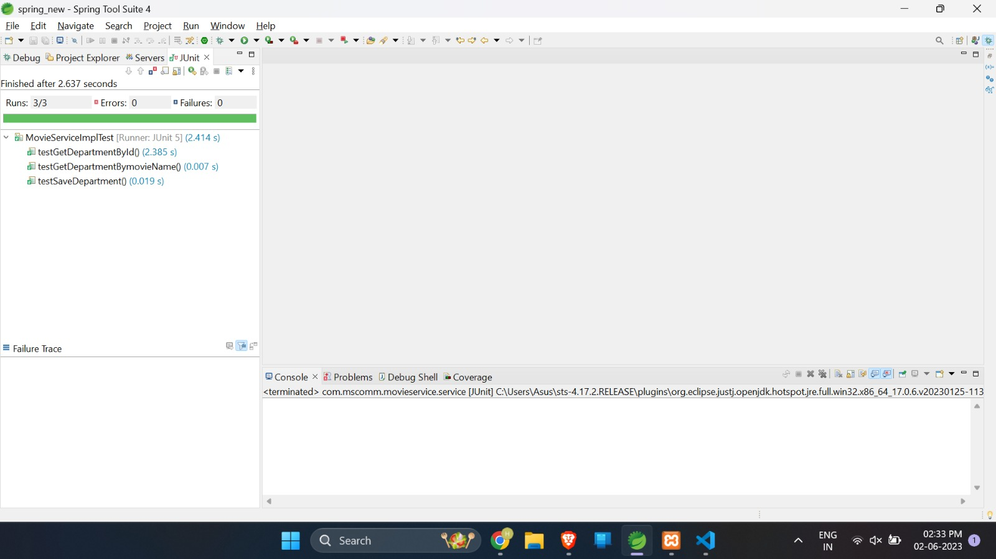
Movie-service service test

Slide 18
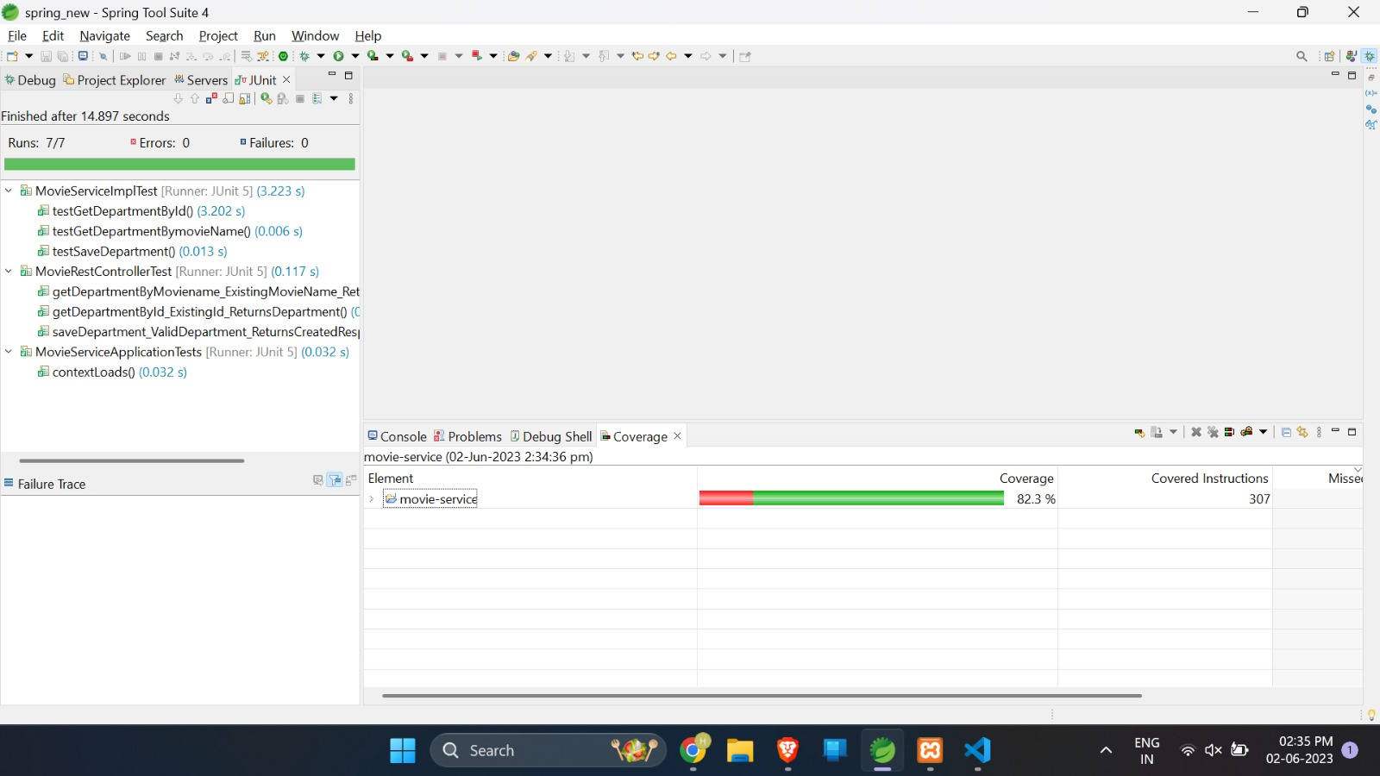
Movie-service code coverage

Slide 19
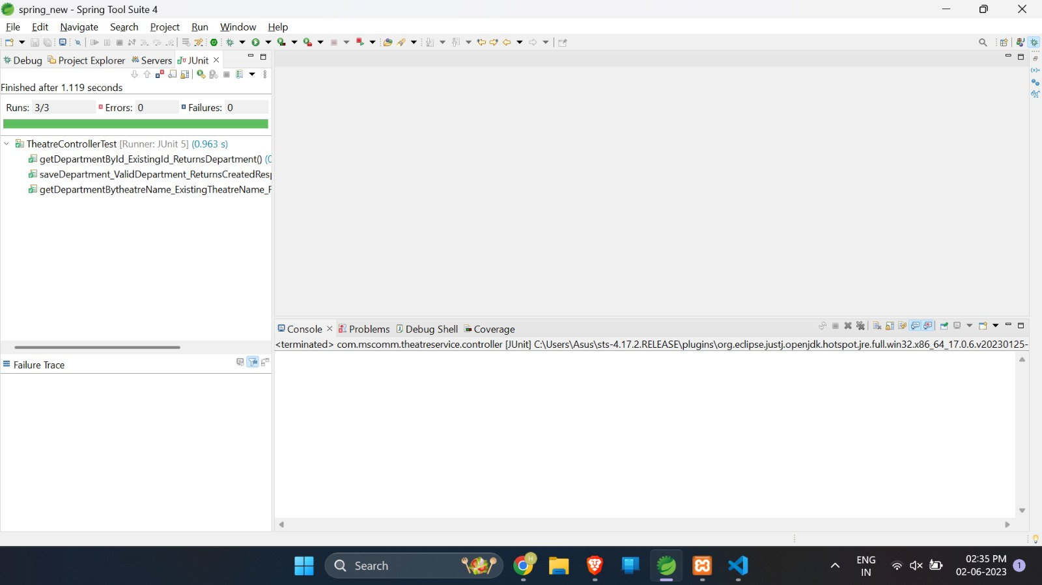
Theatre-service controller test

Slide 20

Theatre-service service test

Slide 21
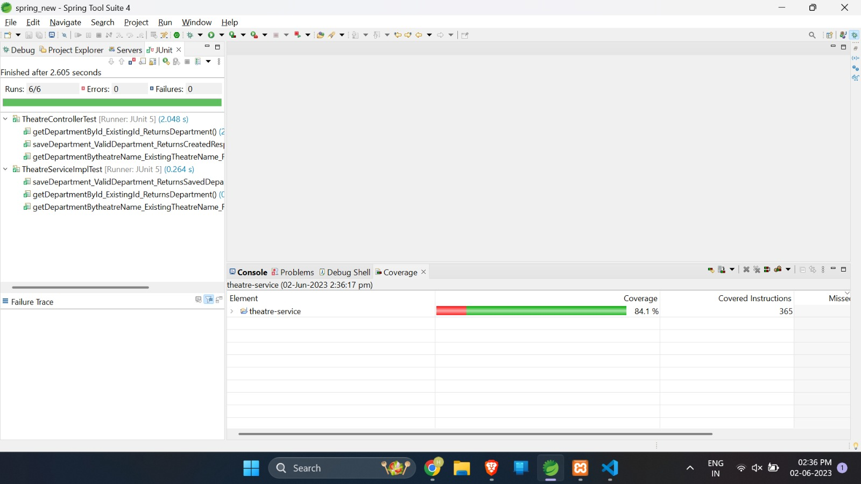
Theatre-service code coverage

Slide 22
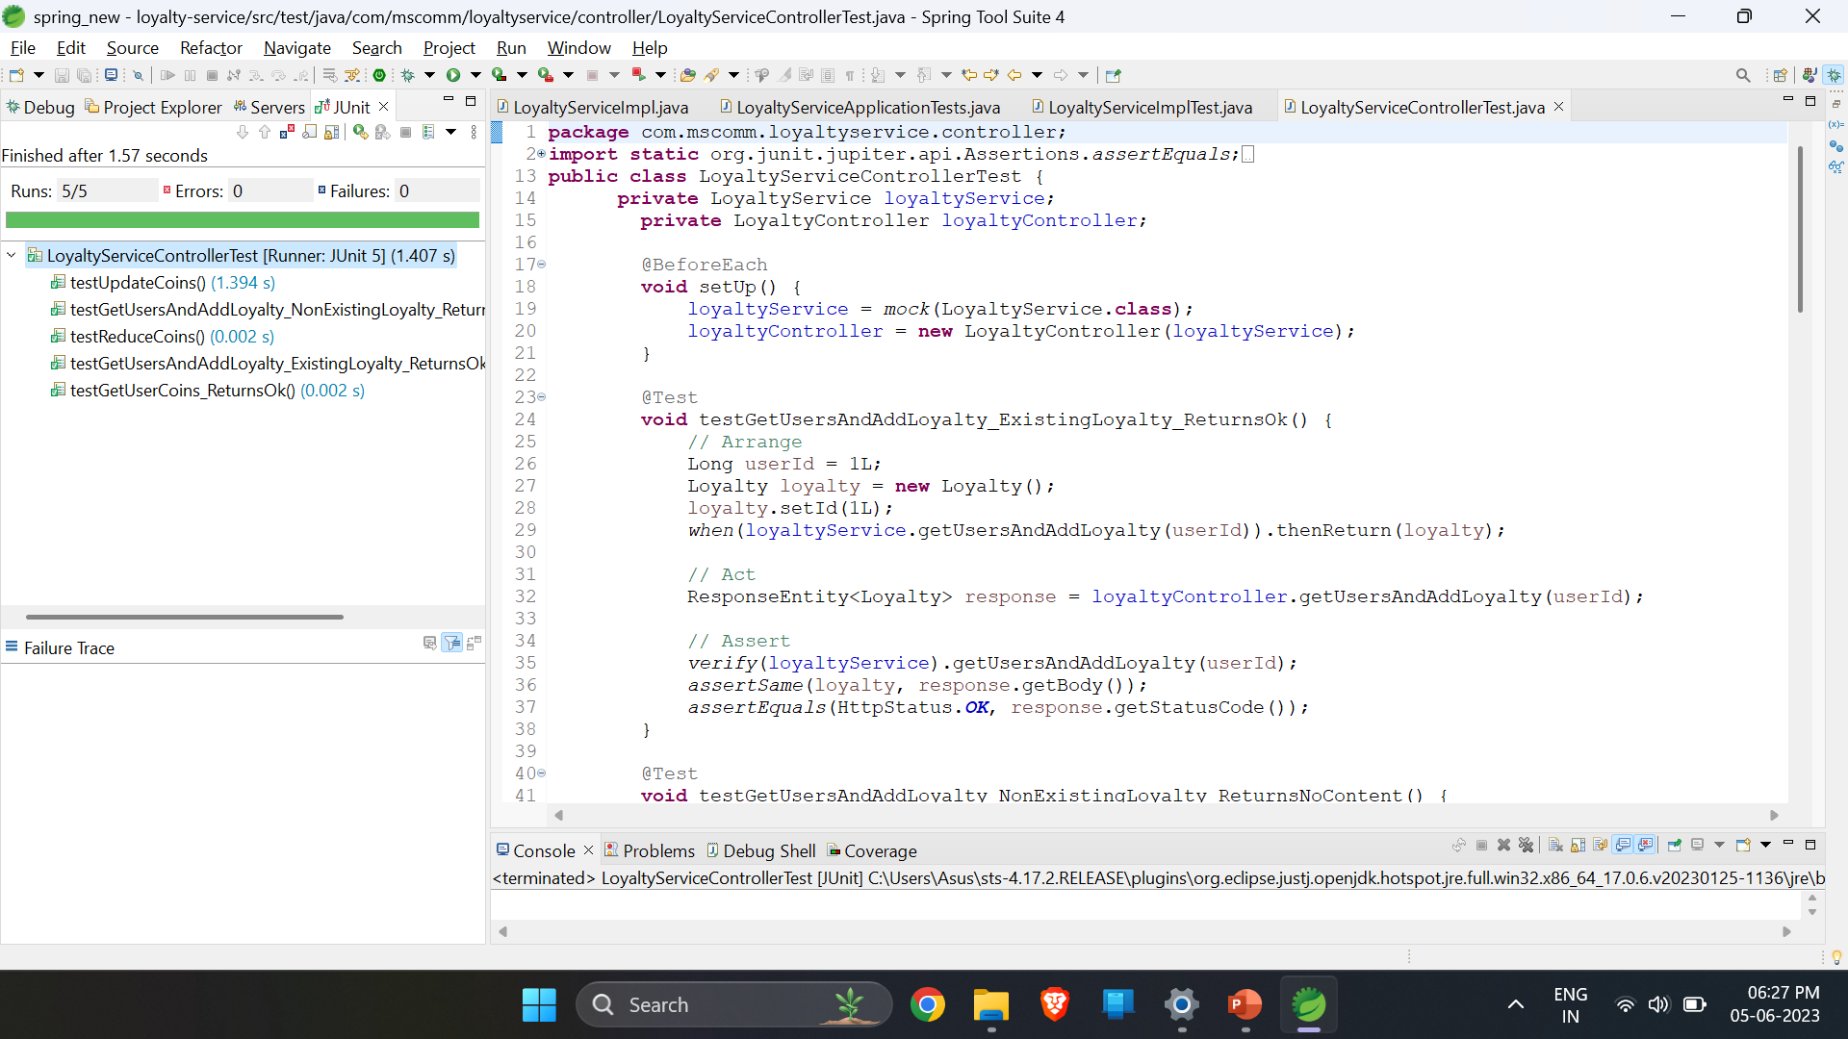
Loyalty-service controller test

Slide 23
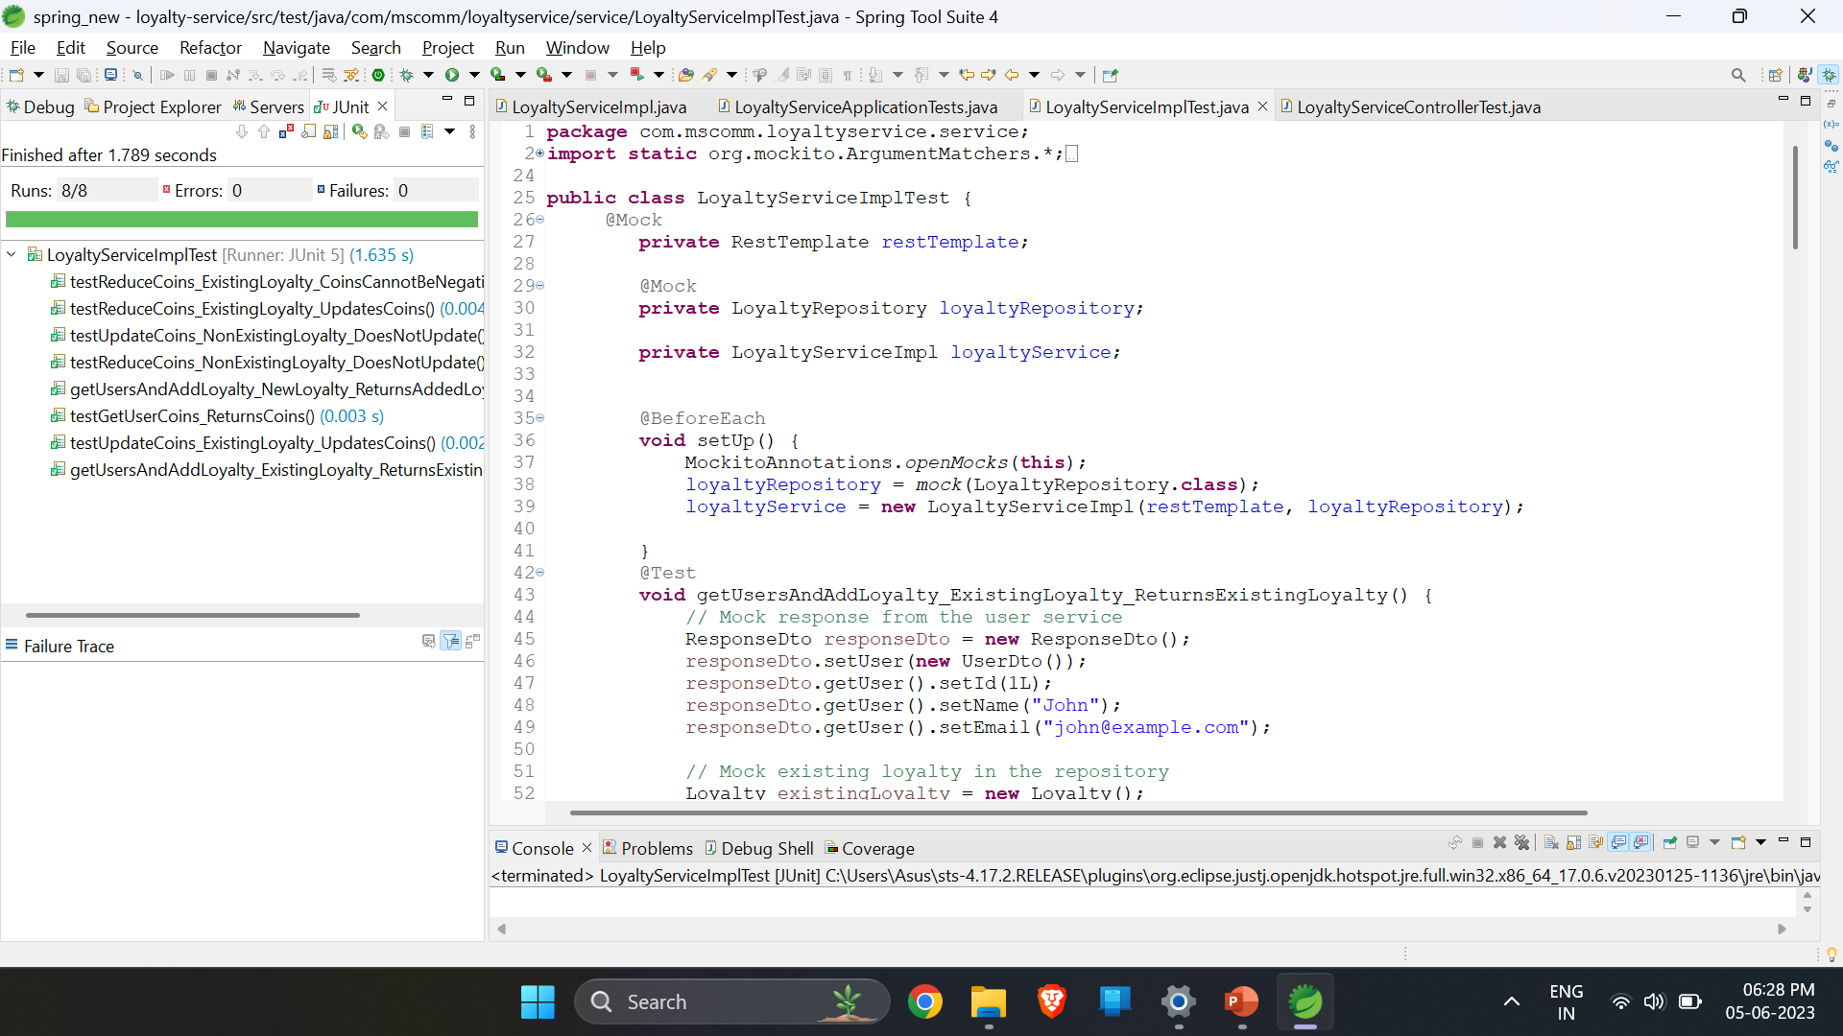
Loyalty-service service test

Slide 24
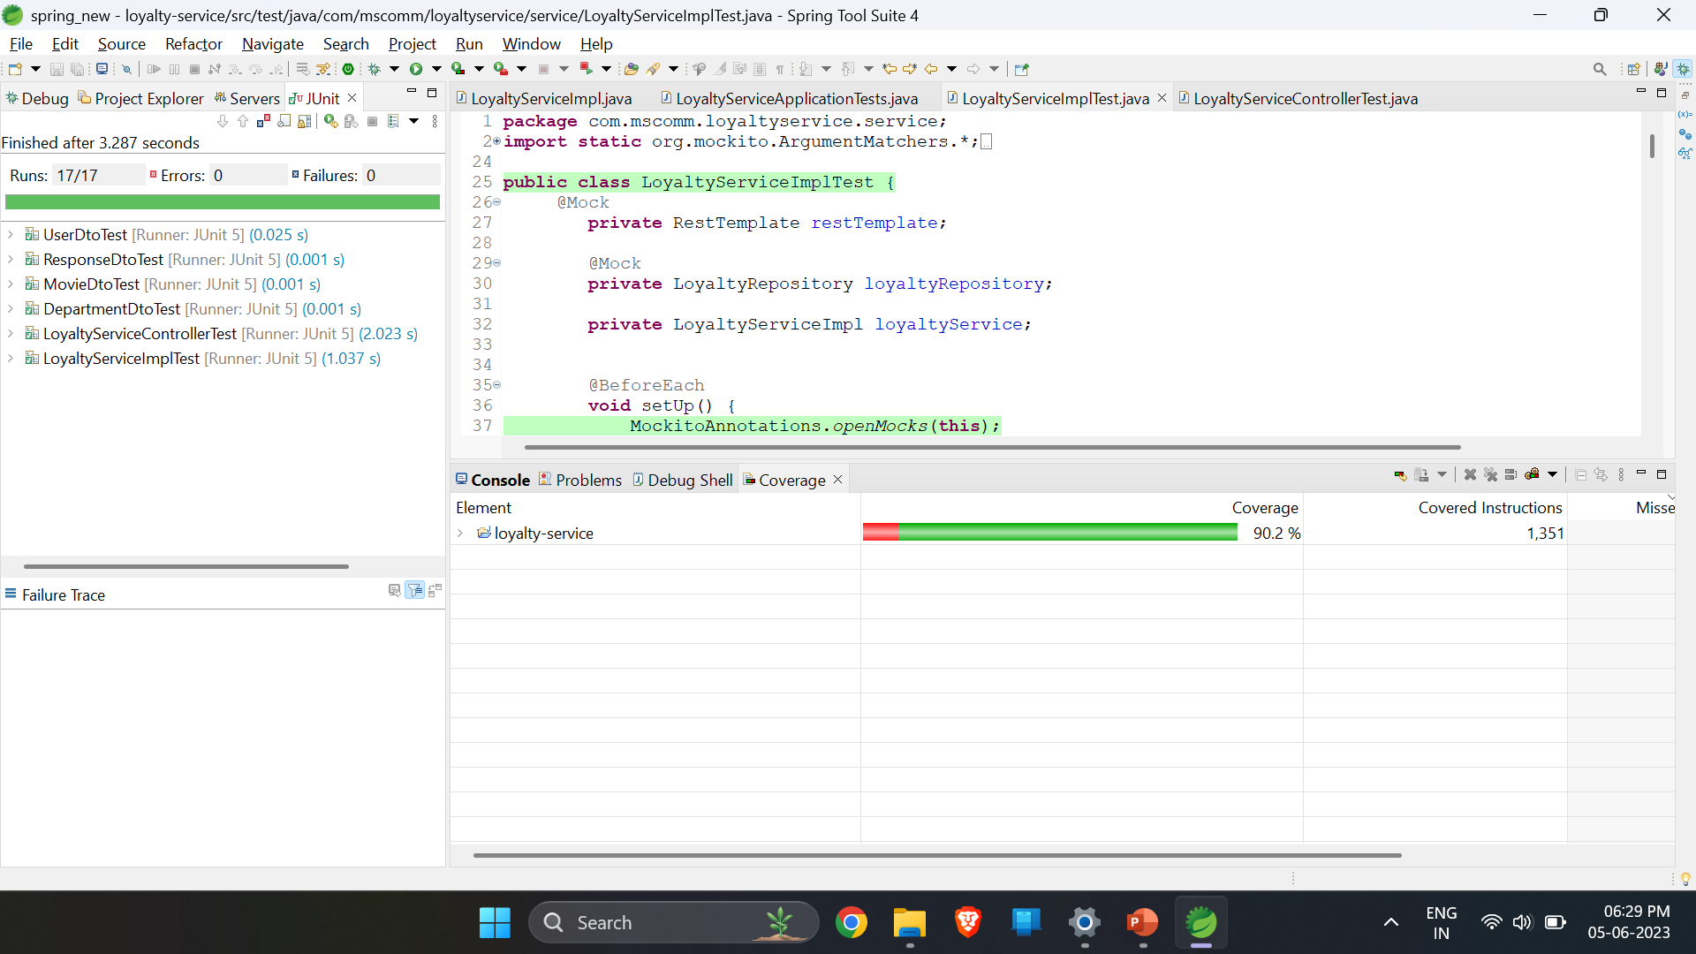
Loyalty-service code coverage

Slide 25
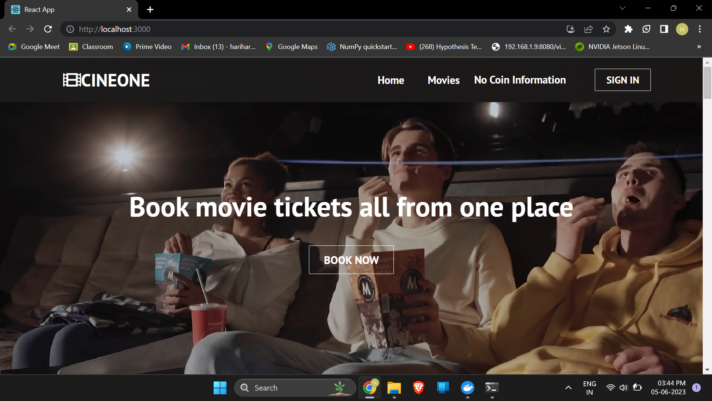
Website Pictures

Slide 26
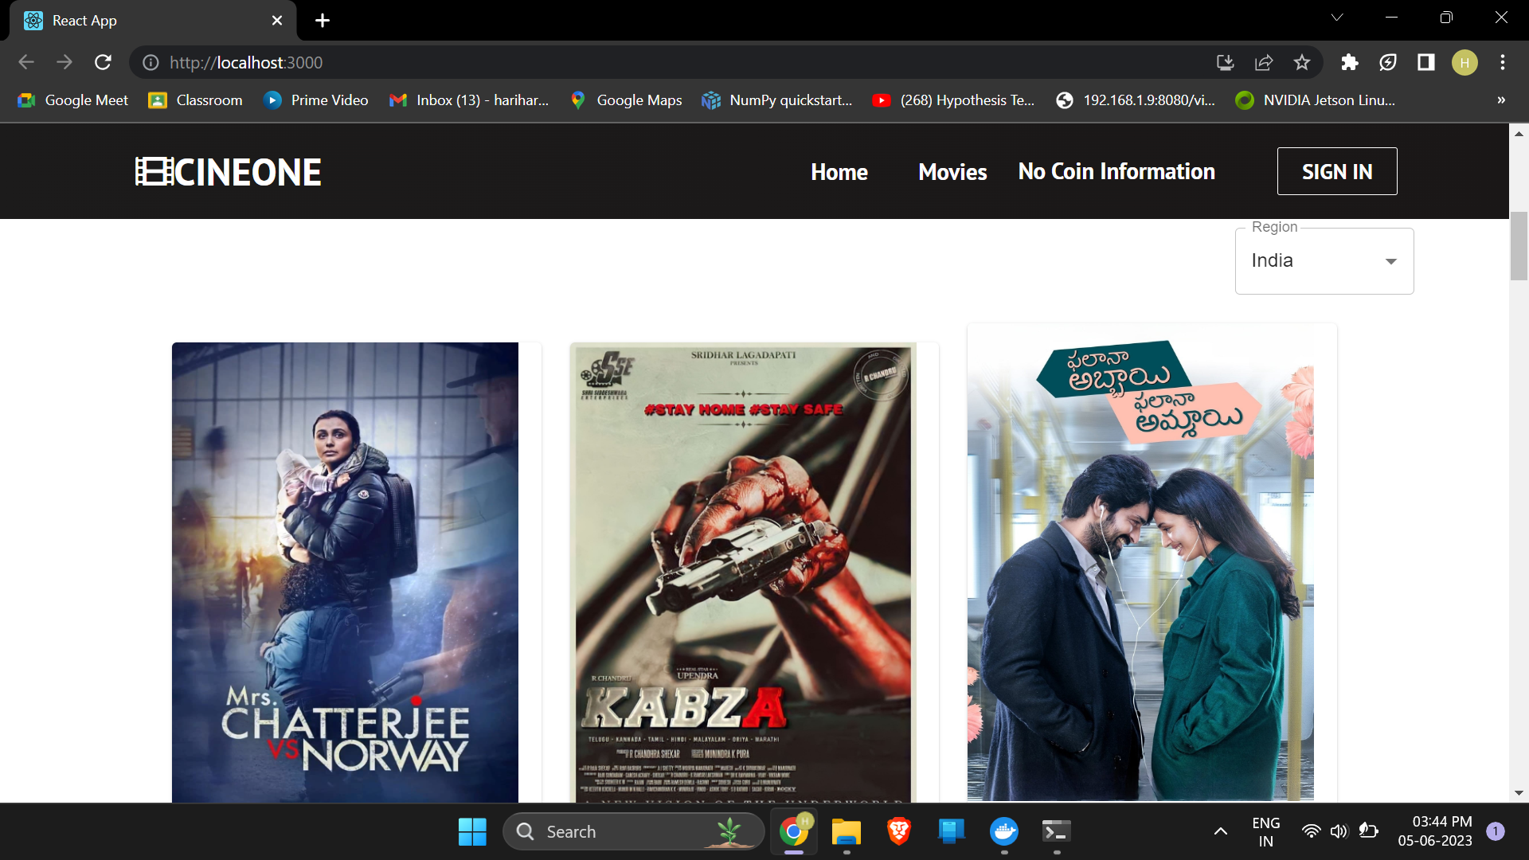
Website Pictures

Slide 27
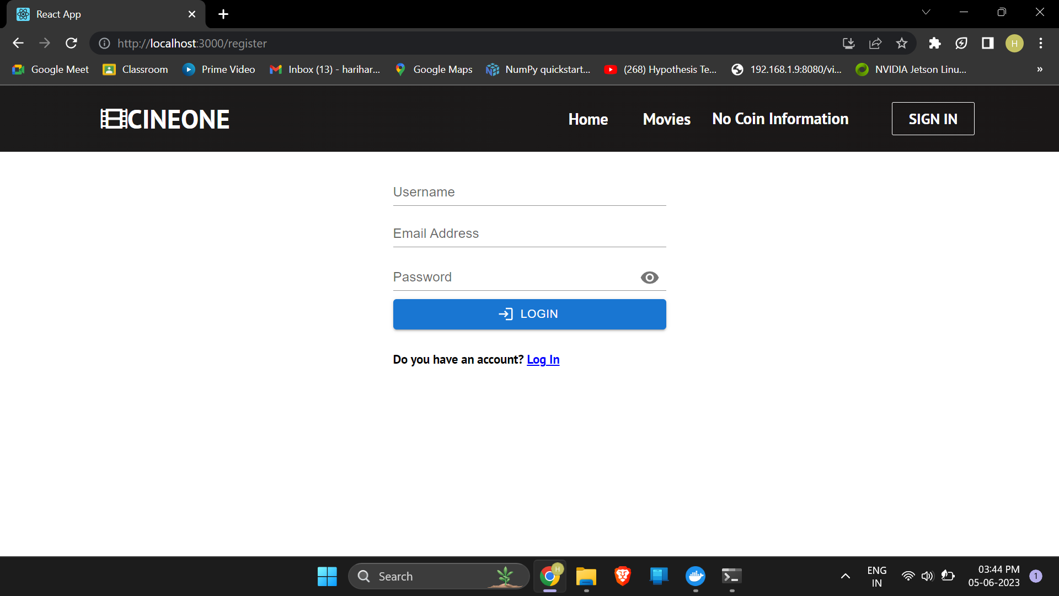
Website Pictures (Login)

Slide 28

Website Pictures (Movies)

Slide 29
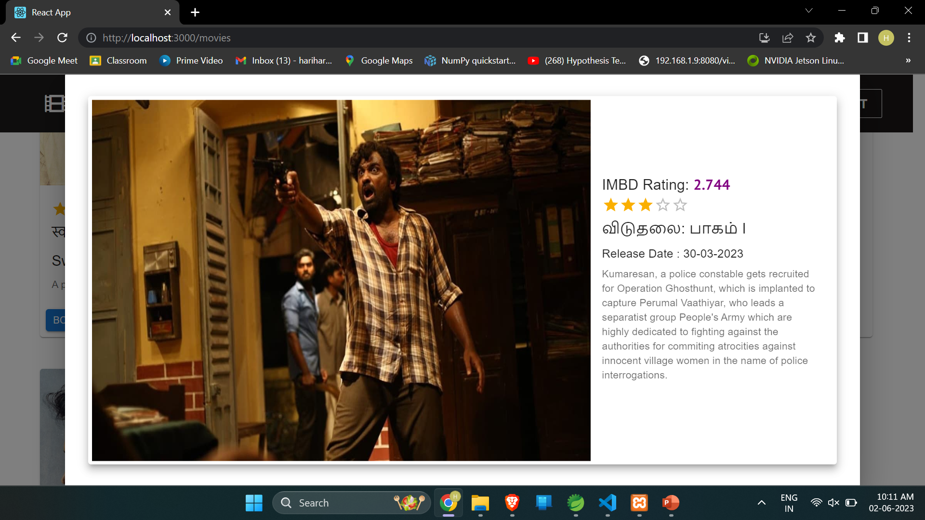
Website Pictures (Movie More Details)

Slide 30
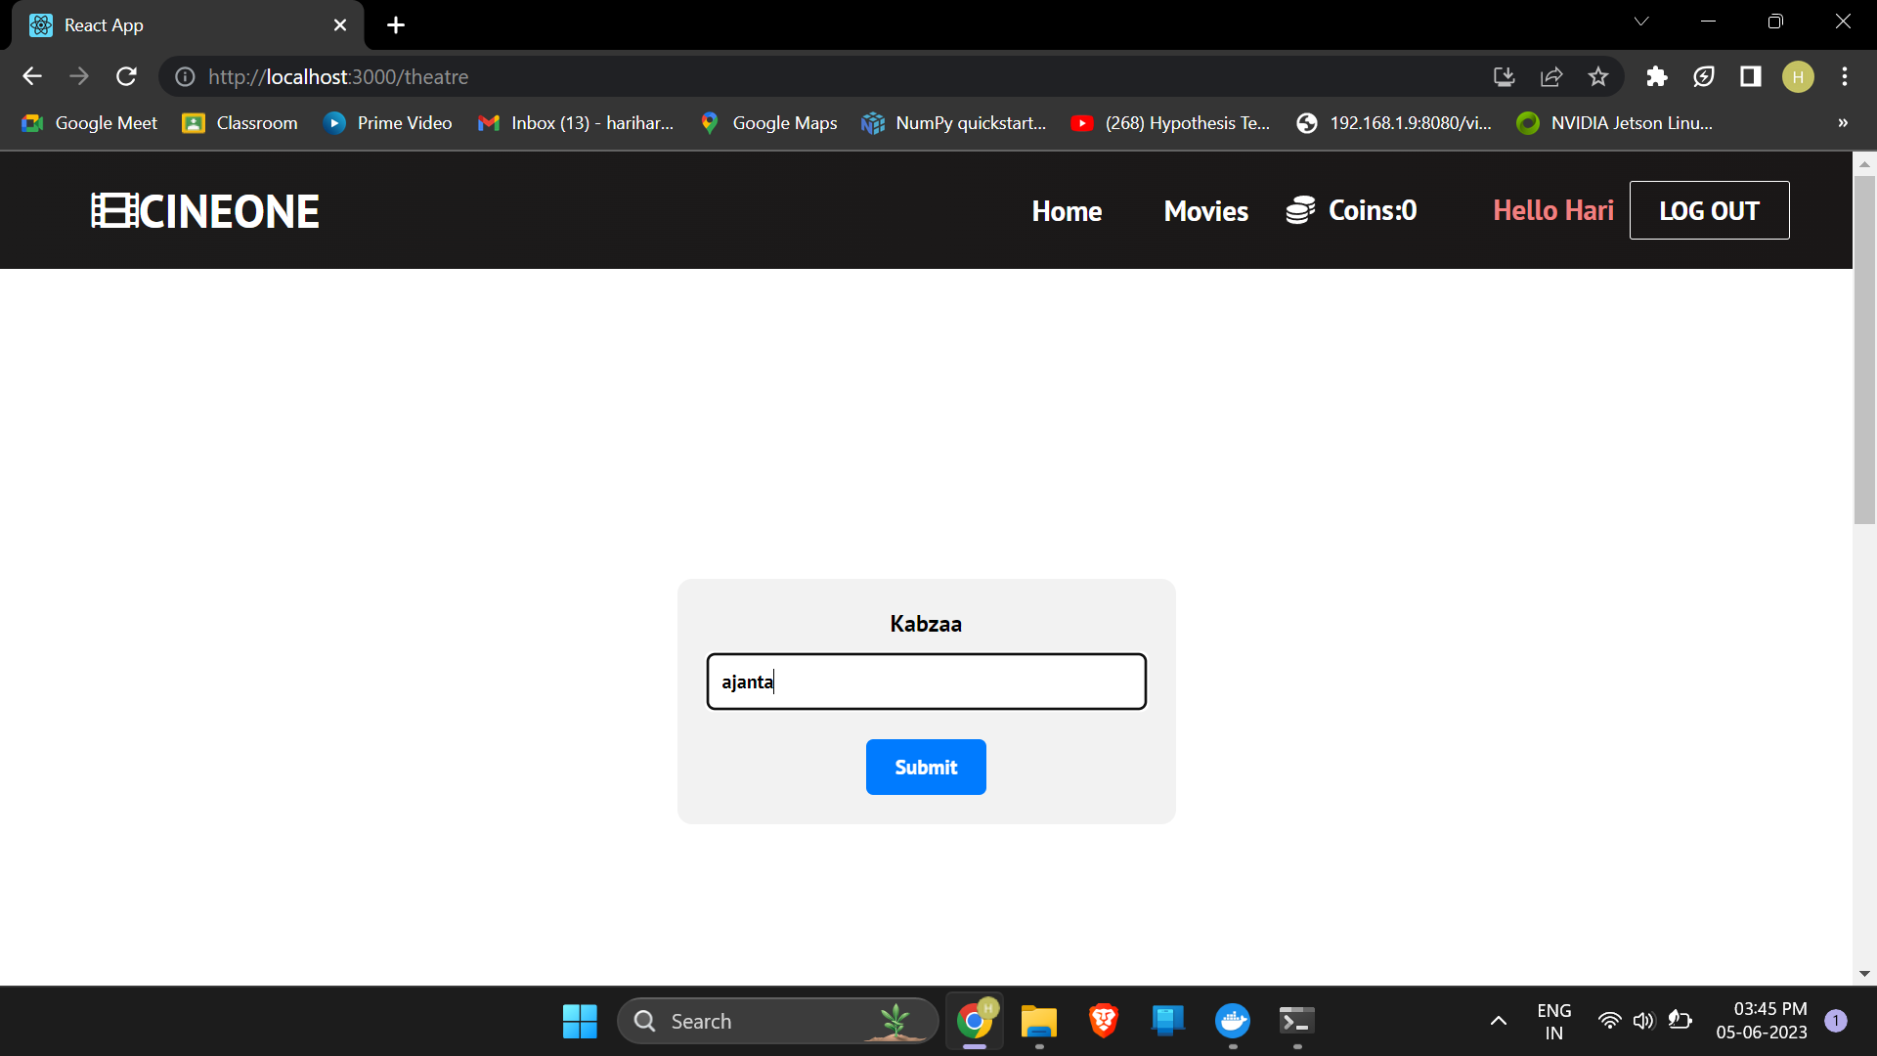
Website Pictures (Select Theatre)

Slide 31
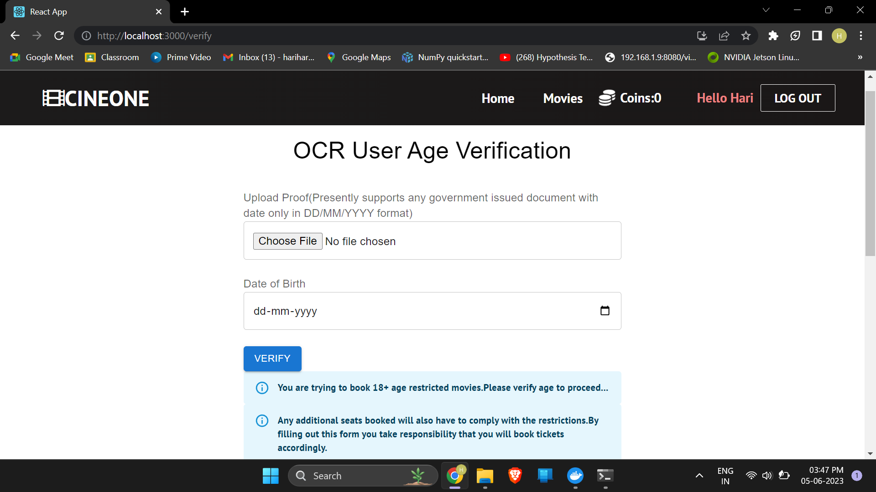
Website Pictures (Age Verification for A Movies)

Slide 32
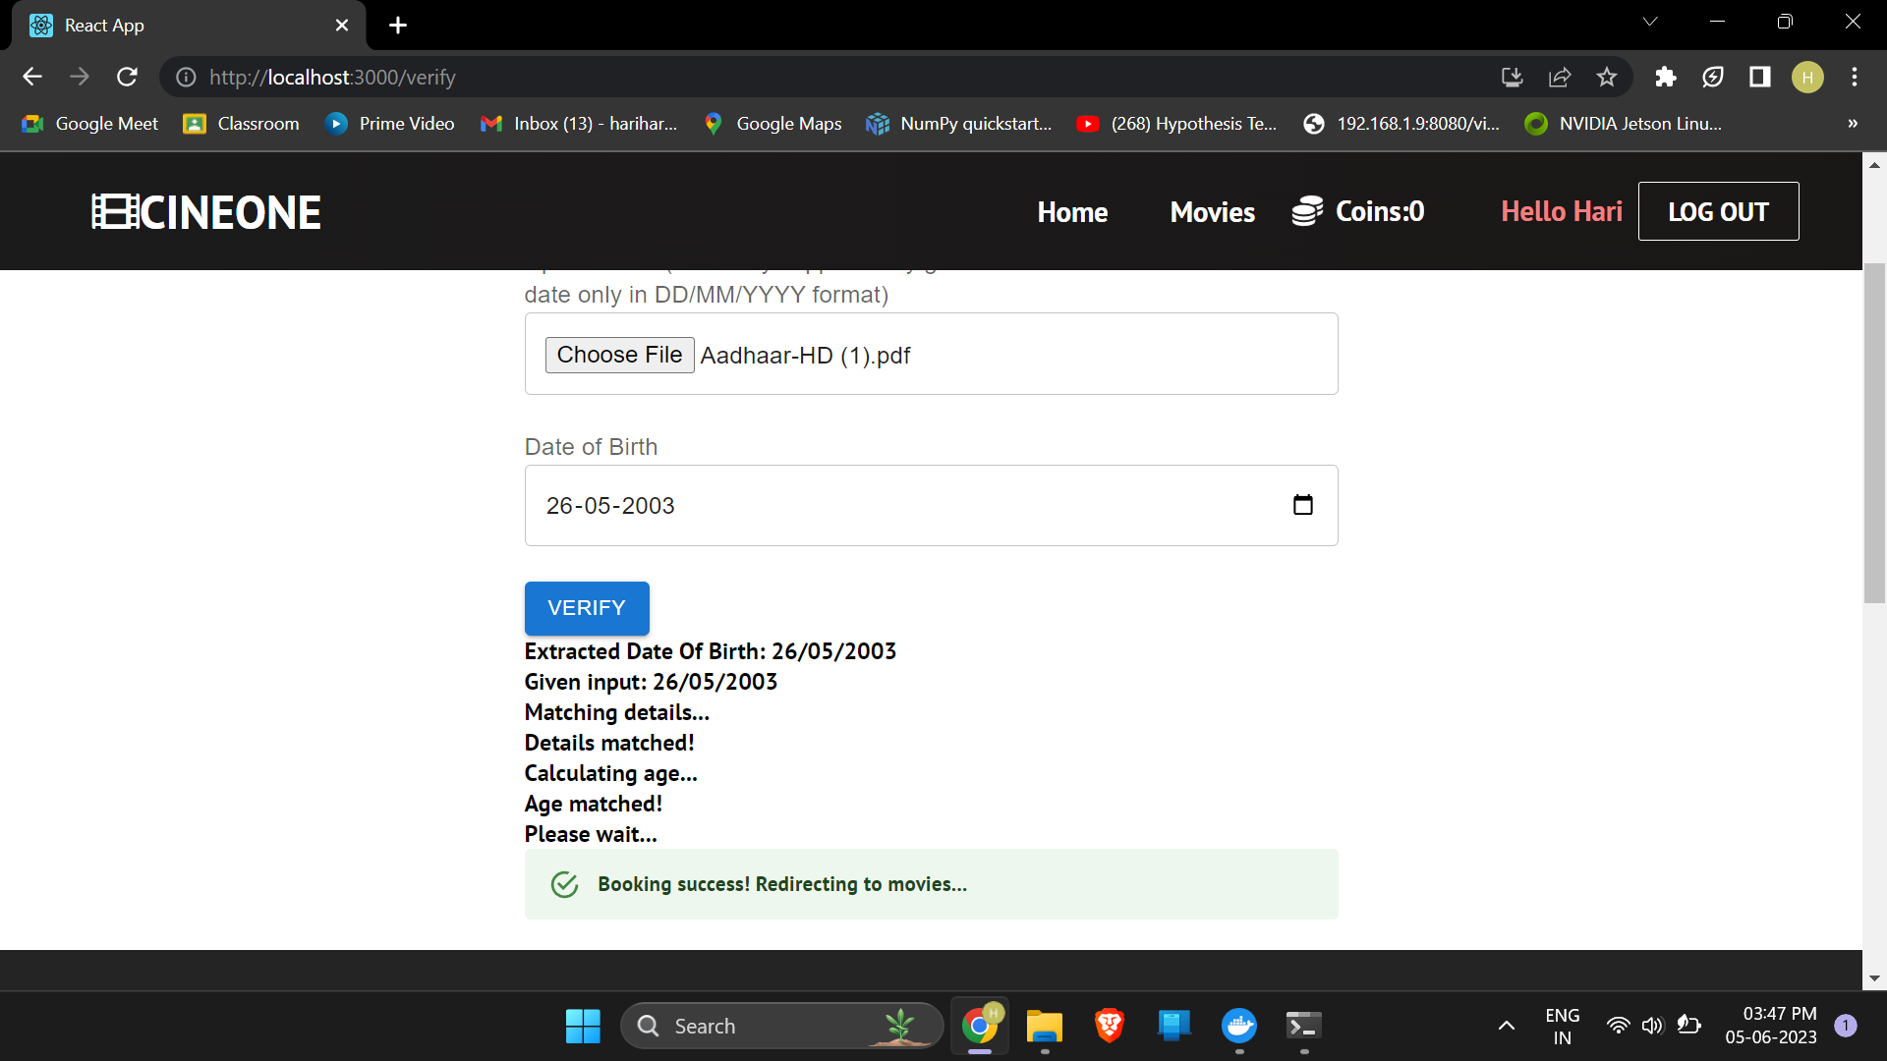
Website Pictures (Calculates age with extracted Date of Birth)

Slide 33
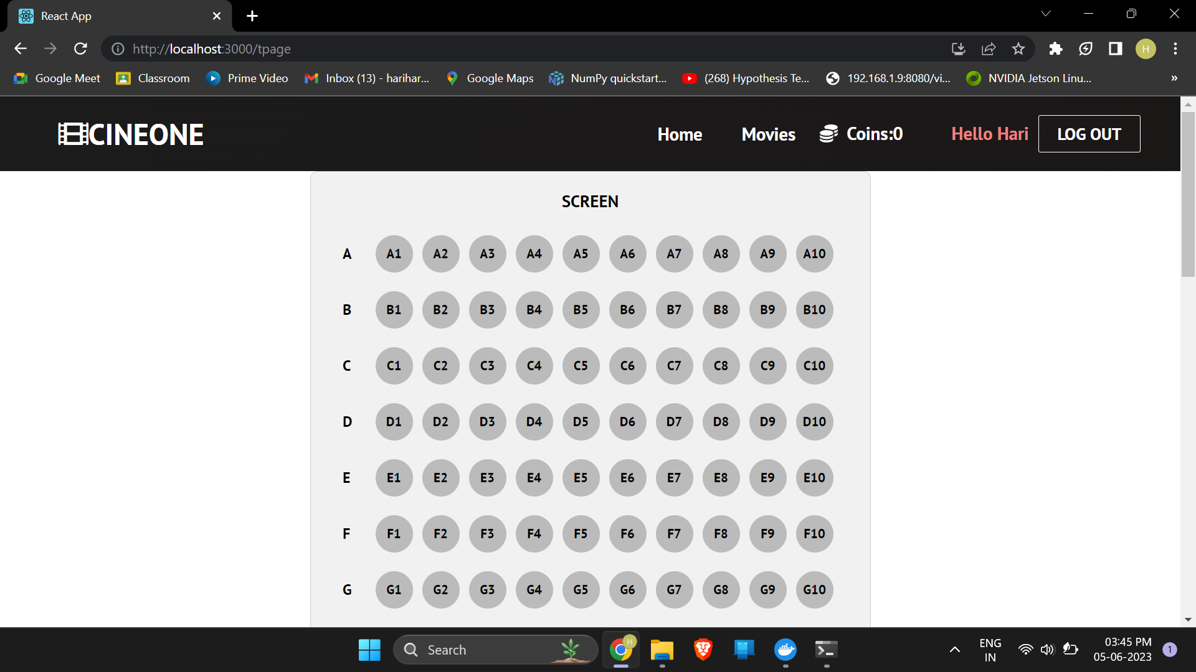
Website Pictures (Seat Details)

Slide 34
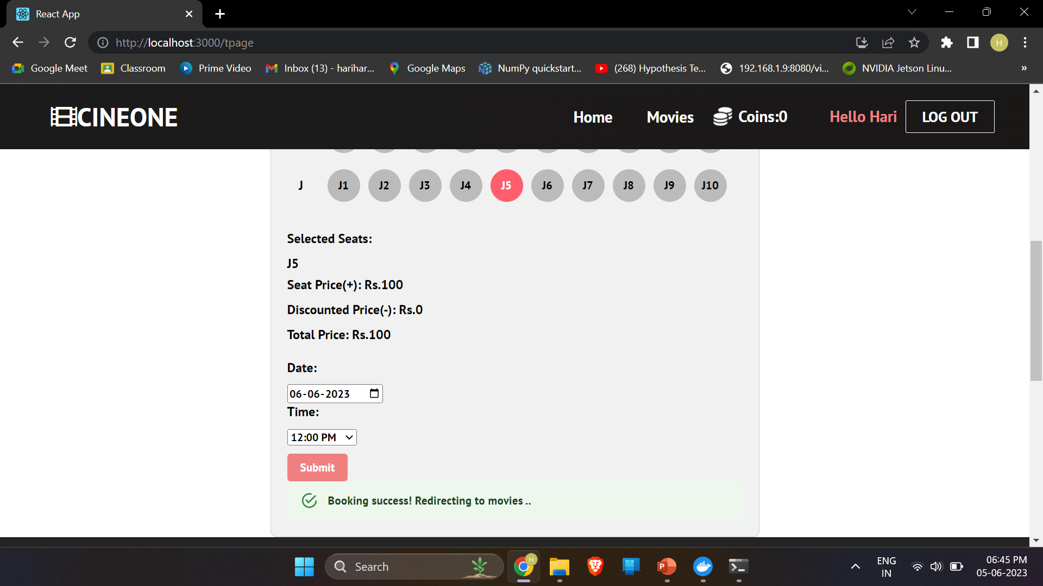
Website Pictures (Seat Details)

Slide 35
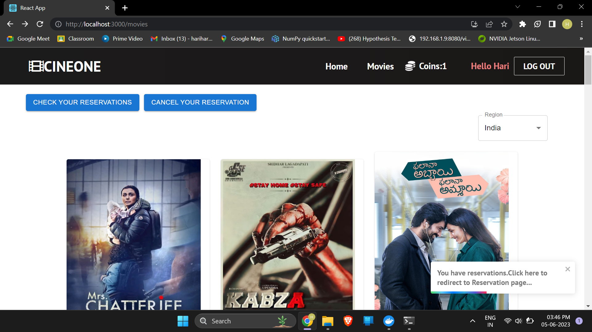
Website Pictures (Home page after reservation)

Slide 36
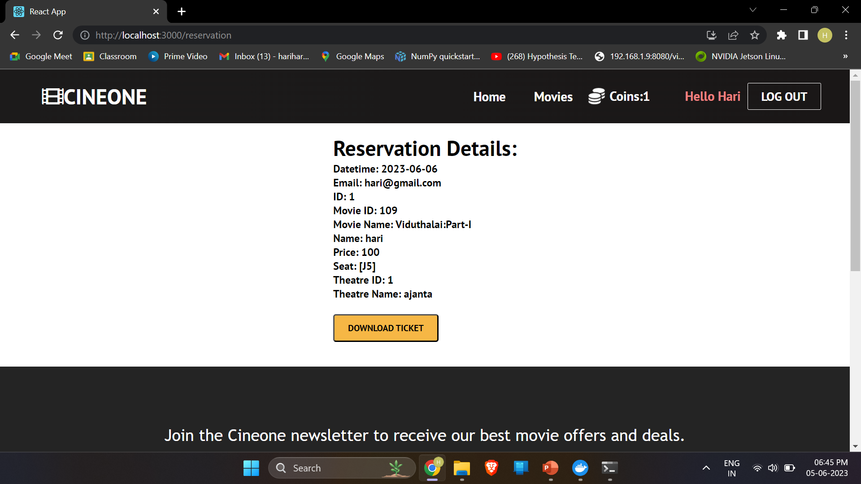
Website Pictures (Reservation Details)

Slide 37
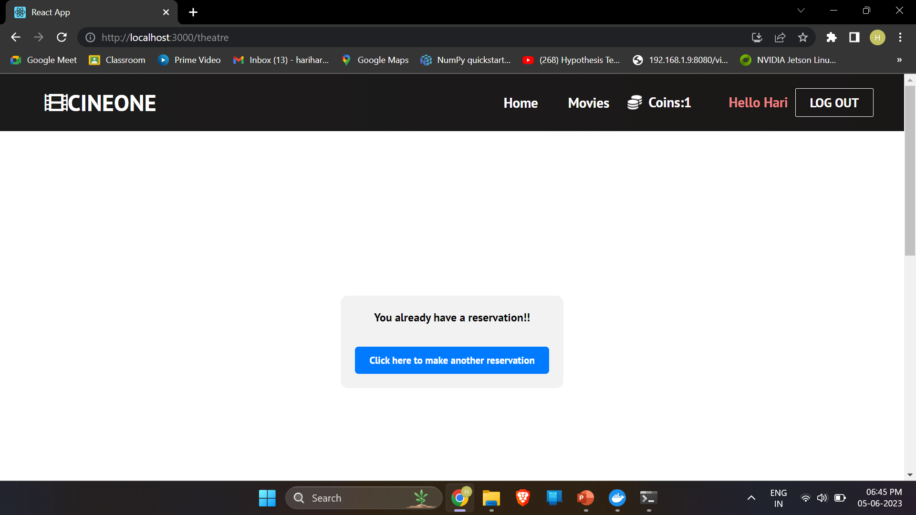
Website Pictures (User needs to sign in separately to book another ticket)

Slide 38
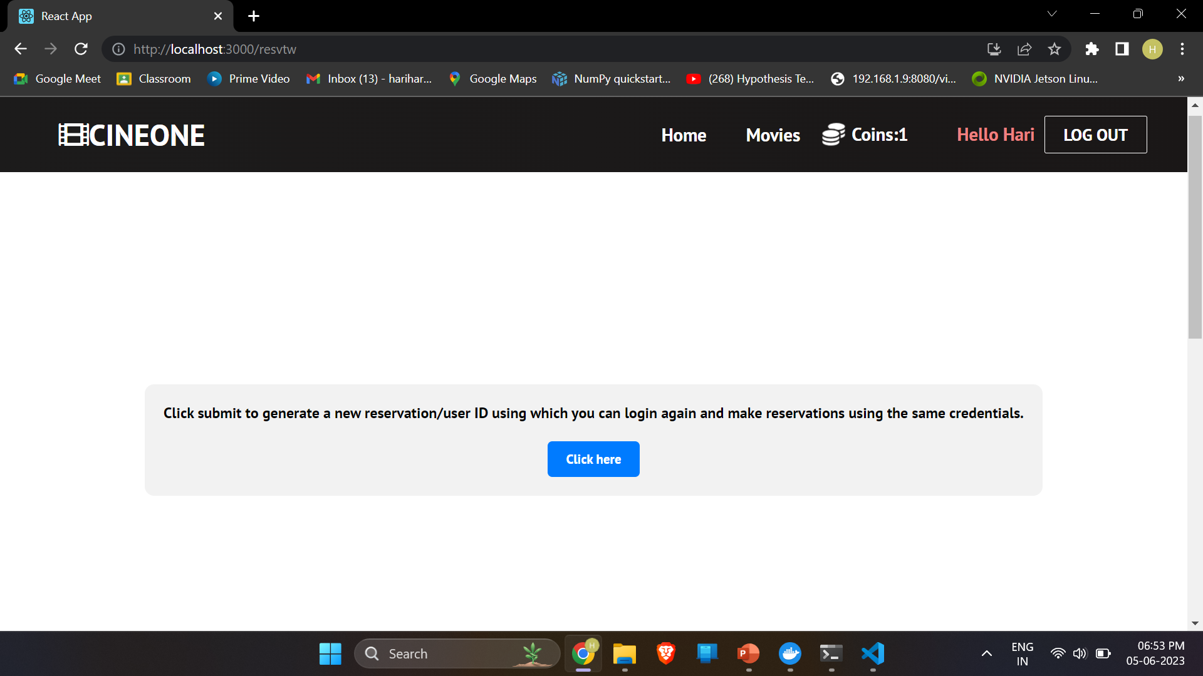
Website Pictures (User needs to sign in separately to book another ticket)

Slide 39
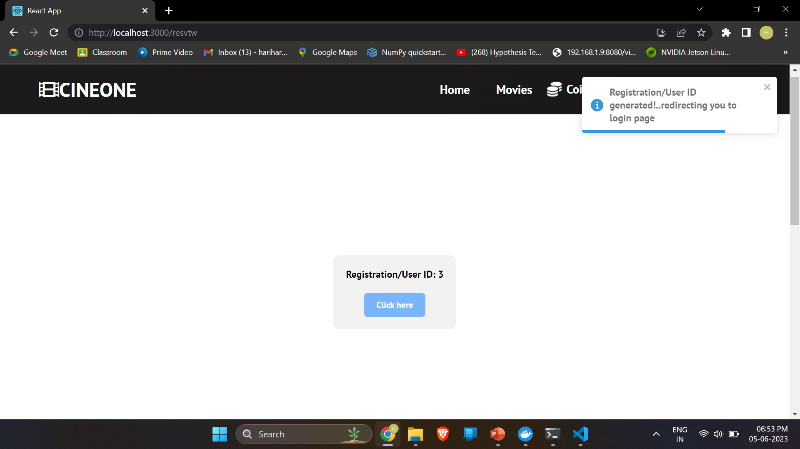
Website Pictures (User uses this ID to book another ticket)

Slide 40
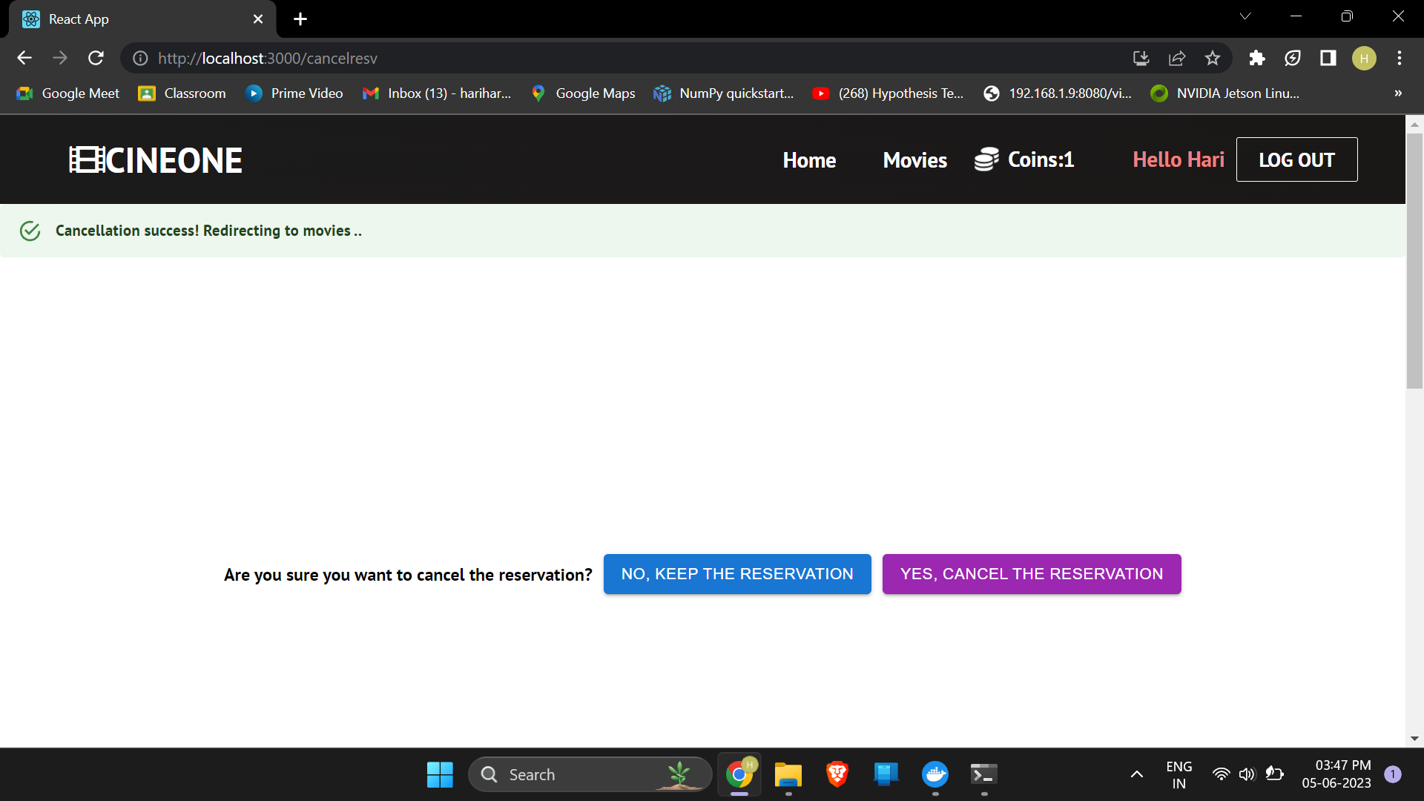
Website Pictures (Booking Cancellation)

Slide 41
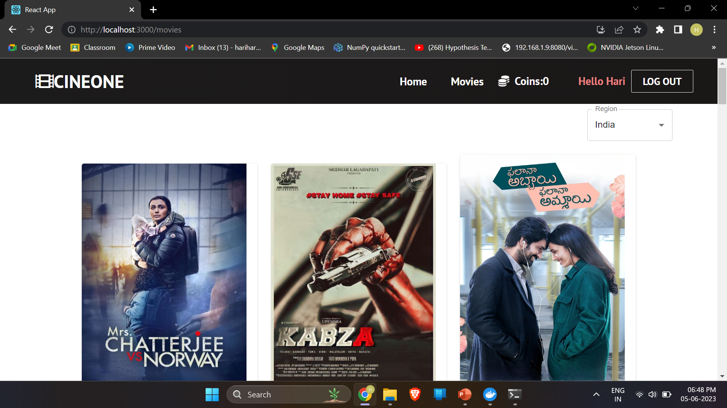
Website Pictures (Home page after cancellation)

